Slide 1
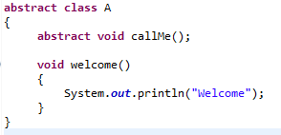
Abstract class in Java
If a class contain any abstract method then the class is declared as abstract class.
An abstract class is never instantiated.
It is used to provide abstraction. Although it does not provide 100% abstraction because it can also have concrete method.
Syntax :
abstract class class_name { }

